Slide 1
An Introduction to Machine Learning
Harrison B. Prosper
Florida State University
YETI 19, Durham University, UK
7 January, 2019

Slide 2
Topics
Introduction
A Bit of Theory
Boosted Decision Trees
Deep Neural Networks
The Future of Machine Learning

Slide 3
Introduction

Slide 4
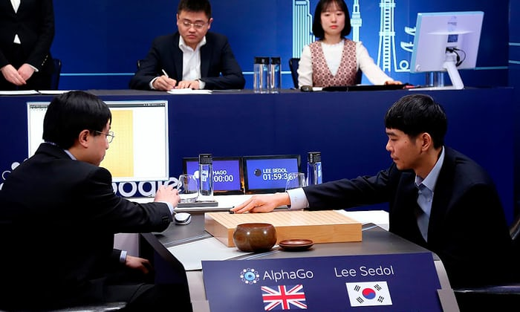
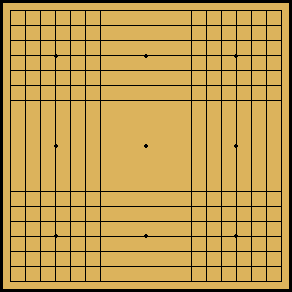
AlphaGo 4, Homo Sapiens 1
2016 – Google’s AlphaGo program beats Go champion Lee Sodol.
Photograph: Yonhap/Reuters

Slide 5
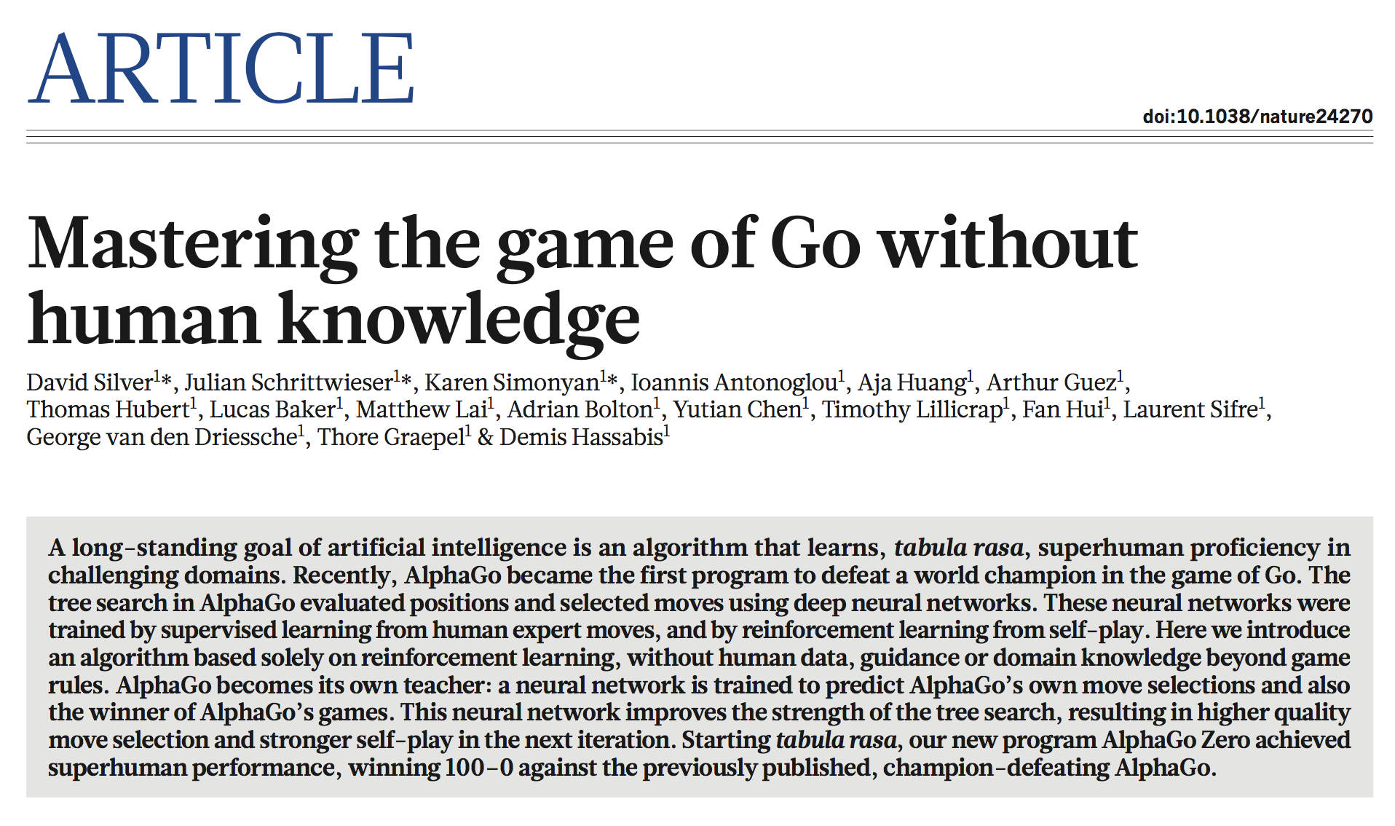
356 | NATURE | VOL 550 | 19 OCTOBER 2017

Slide 7
Follow the Yellow Brick Road!
Giusti et al. treat the problem of trail navigation as a classification problem!
Data: 8 hours of
1920 x 1080 30fps
video using 3 GoPro
cameras.
IEEE Robotics and Automation Letters ( Volume: 1, Issue: 2, July 2016 )

Slide 8
What is Machine Learning?
The use of computer-based algorithms for constructing useful models of data.
Machine learning algorithms fall into five broad categories:
Supervised Learning
Semi-supervised Learning
Unsupervised Learning
Reinforcement Learning
Generative Learning

Slide 9
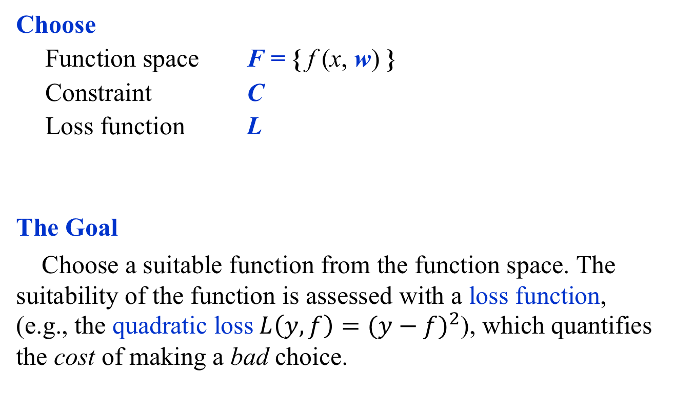
Machine Learning
Choose
Function space F = { f (x, w) }
Constraint C
Loss function L
The Goal
Choose a suitable function from the function space. The suitability of the function is assessed with a loss function, (e.g., the quadratic loss $L\left(y, f\right)={(y−f)}^{2}$), which quantifies the cost of making a bad choice.
F
C(w)
f (x, w*)

Slide 10
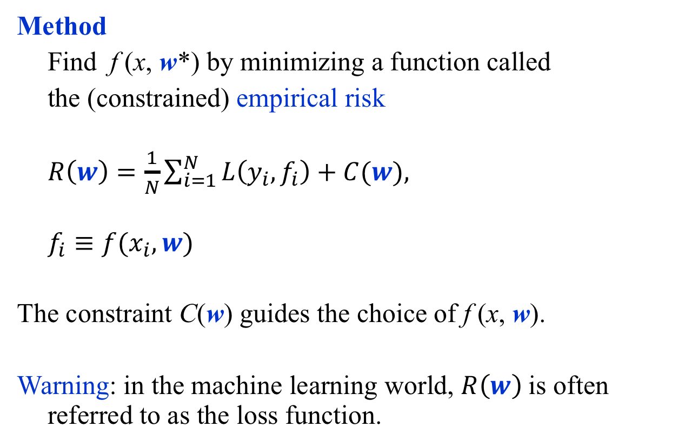
Machine Learning
Method
Find f (x, w*) by minimizing a function called
the (constrained) empirical risk
$R\left(w\right)=\frac{1}{N}\sum_{i=1}^{N}{L\left(y_{i}, f_{i}\right)+C(w),}$
$f_{i}≡f(x_{i},w)$
The constraint C(w) guides the choice of f (x, w).
Warning: in the machine learning world, $R\left(w\right)$is often referred to as the loss function.
F
C(w)
f (x, w*)

Slide 11
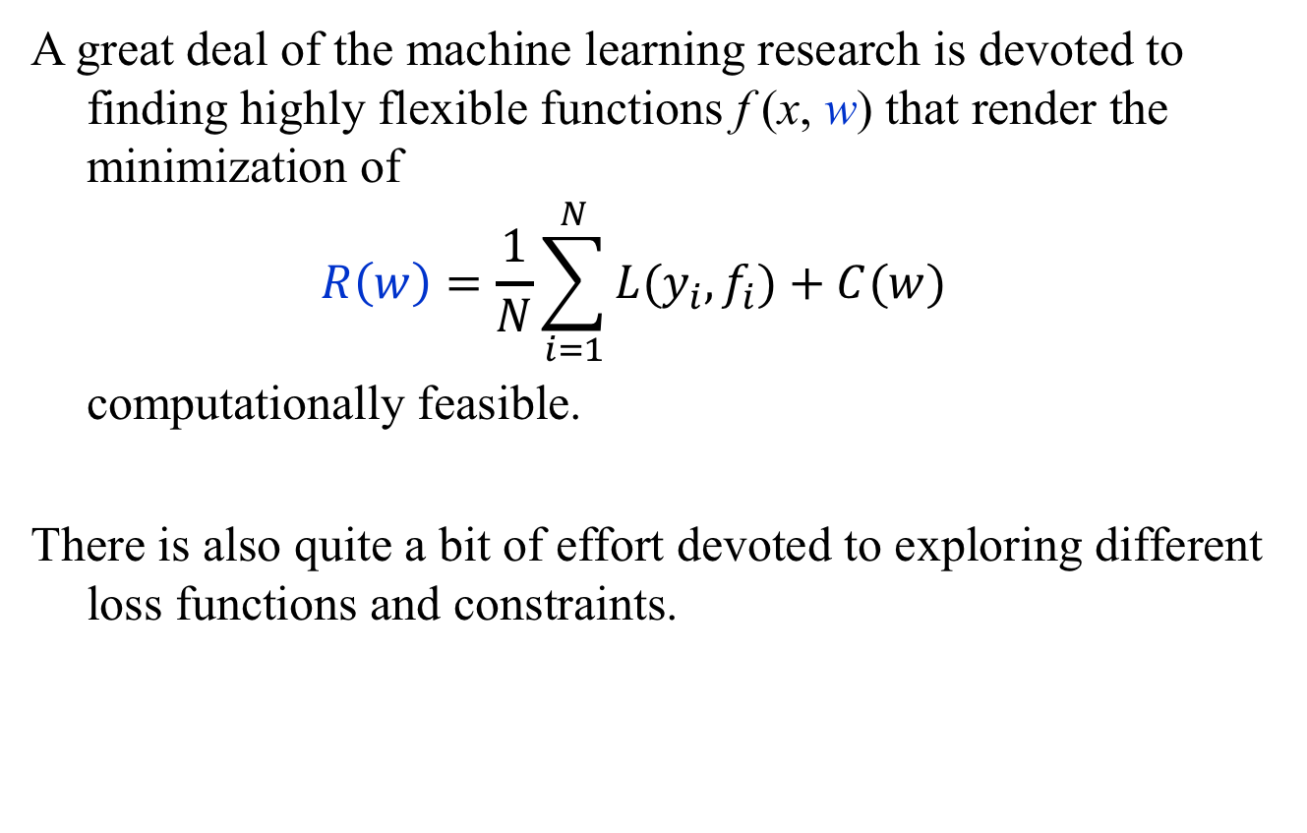
Machine Learning
A great deal of the machine learning research is devoted to finding highly flexible functions f (x, w) that render the minimization of
$$R\left(w\right)=\frac{1}{N}\sum_{i=1}^{N}{L(y_{i},f_{i})}+C(w)$$
computationally feasible.
There is also quite a bit of effort devoted to exploring different loss functions and constraints.

Slide 12
A bit of Theory

Slide 13
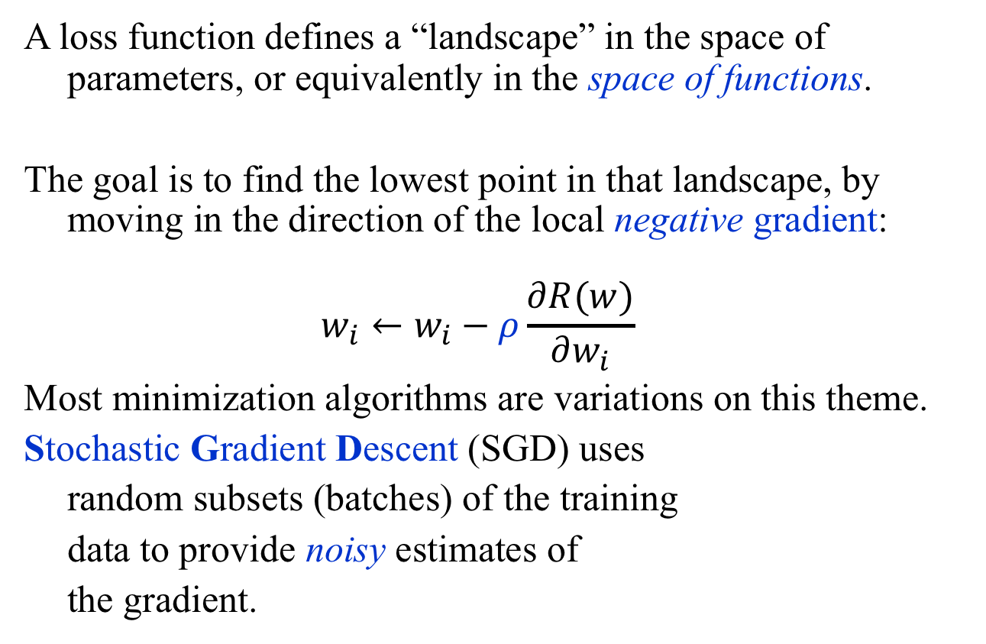
Minimizing the Average Loss
A loss function defines a “landscape” in the space of parameters, or equivalently in the space of functions.
The goal is to find the lowest point in that landscape, by moving in the direction of the local negative gradient:
$$w_{i}←w_{i}−ρ\frac{∂R(w)}{∂w_{i}}$$
Most minimization algorithms are variations on this theme.
Stochastic Gradient Descent (SGD) uses
random subsets (batches) of the training
data to provide noisy estimates of
the gradient.

Slide 14
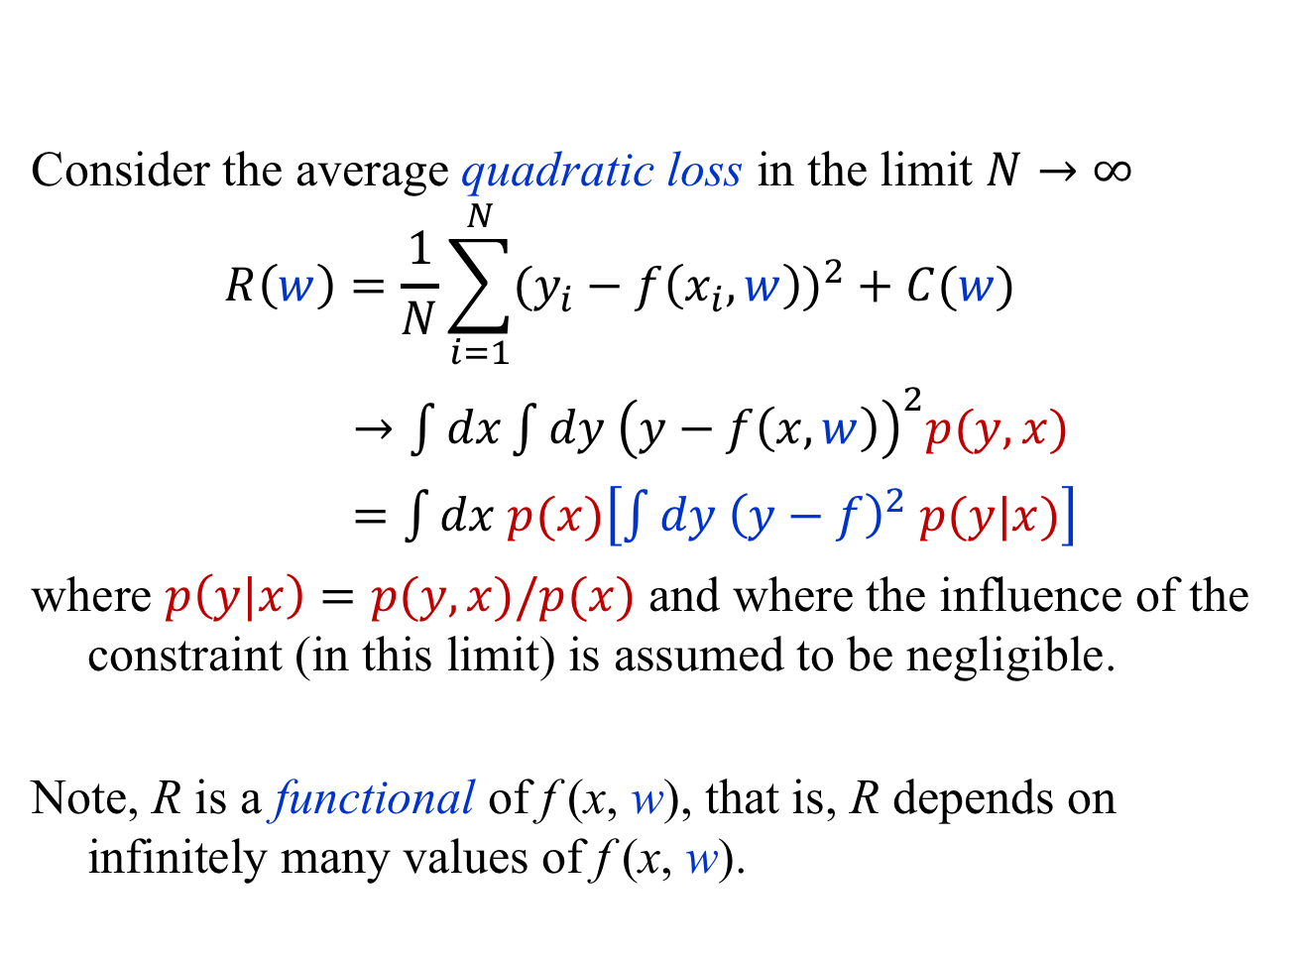
Minimizing the Average Loss
Consider the average quadratic loss in the limit $N→∞$
$$R\left(w\right)=\frac{1}{N}\sum_{i=1}^{N}{{(y_{i}−f\left(x_{i},w\right))}^{2} + C(w)}$$
$→\int{dx\int{dy{ \left(y−f\left(x,w\right)\right)}^{2}p(y,x)}}$
$=\int{dx p(x)\left[\int{dy{ \left(y−f\right)}^{2} p(y|x)}\right]}$
where $p\left(y|x\right)=p(y,x)/p(x)$ and where the influence of the constraint (in this limit) is assumed to be negligible.
Note, R is a functional of f (x, w), that is, R depends on infinitely many values of f (x, w).

Slide 15
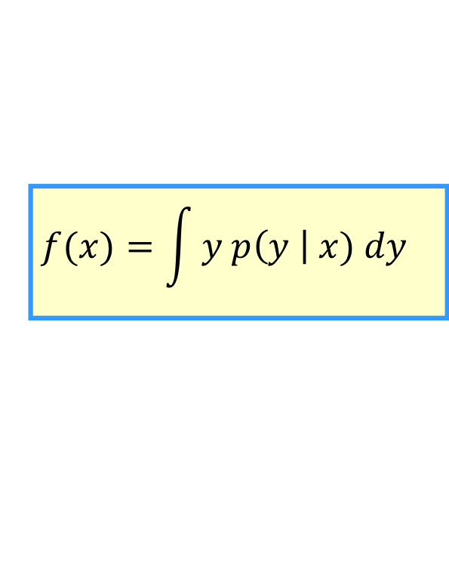
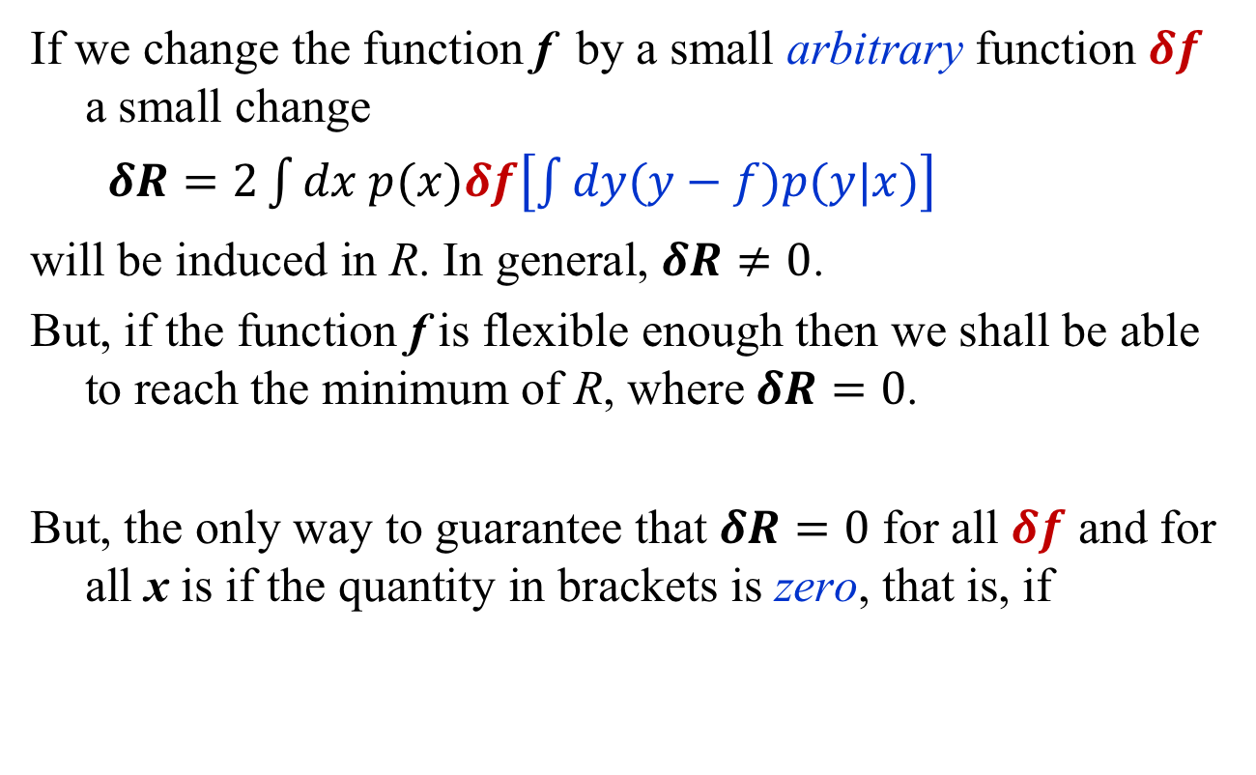
Minimizing the Average Loss
If we change the function f by a small arbitrary function $δf$ a small change
$δR=2\int{dx p(x)δf\left[\int{dy(y−f)p(y|x)}\right]}$
will be induced in R. In general, $δR≠0$.
But, if the function f is flexible enough then we shall be able to reach the minimum of R, where$δR=0$.
But, the only way to guarantee that $δR=0$ for all $δf$ and for all x is if the quantity in brackets is zero, that is, if
$$f(x)=\int{y p\left(y \right| x) dy}$$

Slide 16
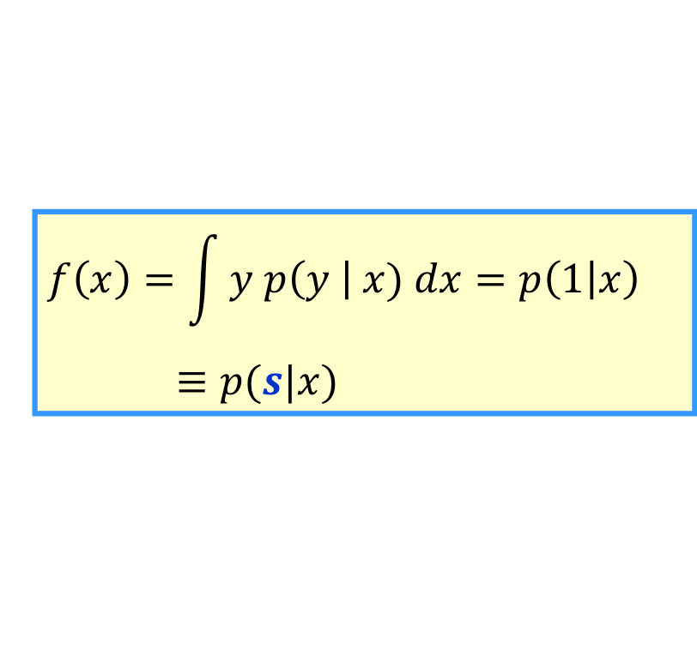
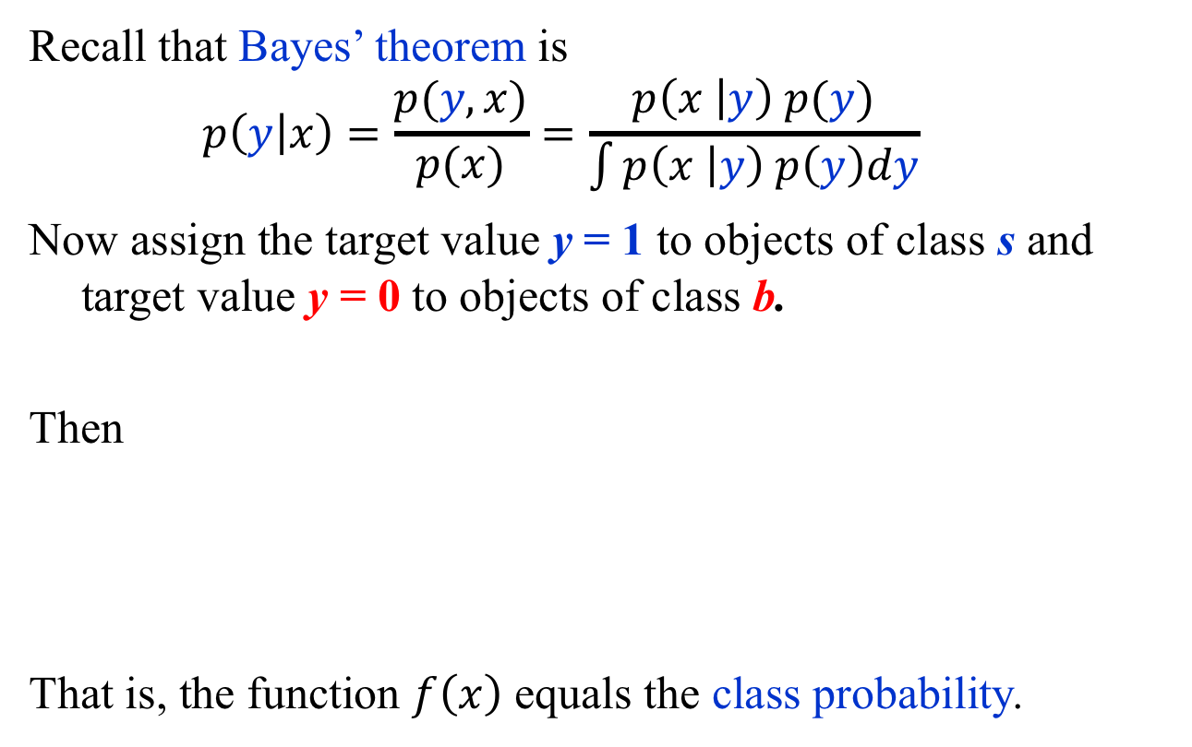
Classification
Recall that Bayes’ theorem is
$$p\left(y | x\right)=\frac{p(y,x)}{p(x)}=\frac{p\left(x | y\right) p(y)}{\int{p\left(x | y\right) p\left(y\right)dy}}$$
Now assign the target value y = 1 to objects of class s and target value y = 0 to objects of class b.
Then
That is, the function $f\left(x\right)$ equals the class probability.
$$f\left(x\right)=\int{y p\left(y \right| x) dx}=p\left(1 | x\right)$$
$≡p(s|x)$

Slide 17
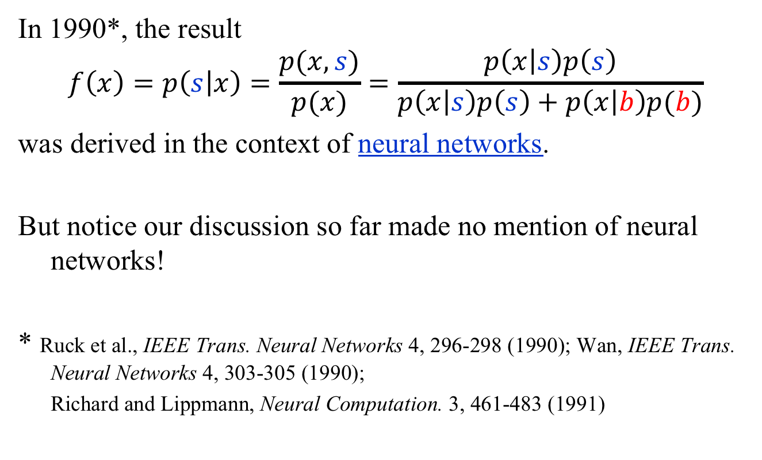
Classification
In 1990*, the result
$$f\left(x\right)=p\left(s | x\right)=\frac{p(x, s)}{p(x)}=\frac{p\left(x | s\right)p\left(s\right)}{p\left(x | s\right)p\left(s\right)+p\left(x | b\right)p(b)}$$
was derived in the context of neural networks.
But notice our discussion so far made no mention of neural networks!
* Ruck et al., IEEE Trans. Neural Networks 4, 296-298 (1990); Wan, IEEE Trans. Neural Networks 4, 303-305 (1990);
Richard and Lippmann, Neural Computation. 3, 461-483 (1991)

Slide 18
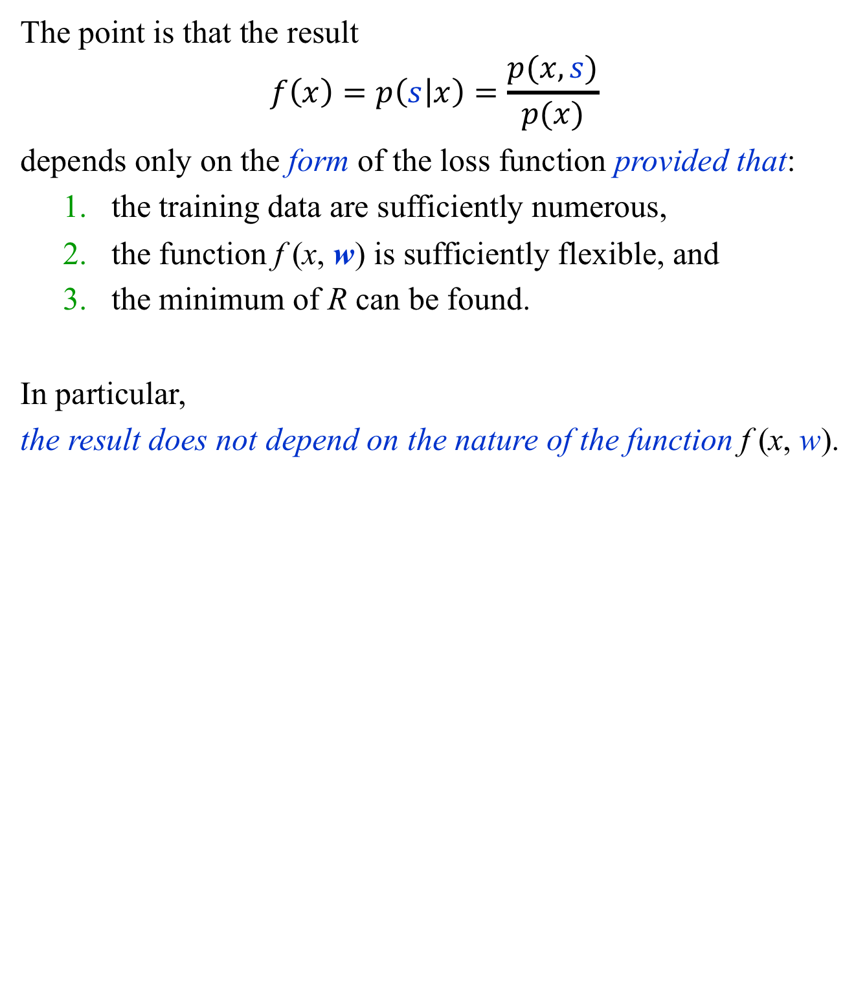
Classification
The point is that the result
$$f\left(x\right)=p\left(s | x\right)=\frac{p(x, s)}{p(x)}$$
depends only on the form of the loss function provided that:
the training data are sufficiently numerous,
the function f (x, w) is sufficiently flexible, and
the minimum of R can be found.
In particular,
the result does not depend on the nature of the function f (x, w).

Slide 19
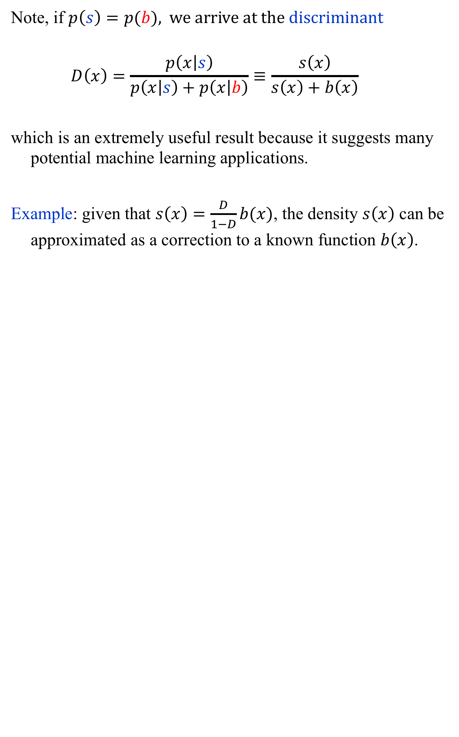
Classification
Note, if $p\left(s\right)=p(b)$, we arrive at the discriminant
$$D\left(x\right)=\frac{p\left(x | s\right)}{p\left(x | s\right)+p\left(x | b\right)}≡\frac{s\left(x\right)}{s\left(x\right)+b\left(x\right)}$$
which is an extremely useful result because it suggests many potential machine learning applications.
Example: given that $s\left(x\right)=\frac{D}{1−D}b(x)$, the density $s\left(x\right)$ can be approximated as a correction to a known function $b\left(x\right)$.

Slide 20
Boosted decision trees

Slide 21
Decision Trees
Decision tree:
a sequence of if then else
statements.
Basic idea: recursively
partition the space into
regions of diminishing impurity.
This is a simple example of an
automated wine taster…more
later…!

Slide 22
Decision Trees
For each variable, find the partition (“cut”) that gives the greatest decrease in impurity:
Impurity (parent)
– Impurity (“left”)
– Impurity (“right”)
Then, choose the best partition among all partitions, and repeat with each child.

Slide 23
Decision Trees
The most common impurity measure is the Gini index
(Corrado Gini, 1884-1965):
Gini index = p (1 – p)
where p is the purity
p = S / (S + B)
p = 0 or 1 = maximal purity
p = 0.5 = maximal impurity

Slide 24
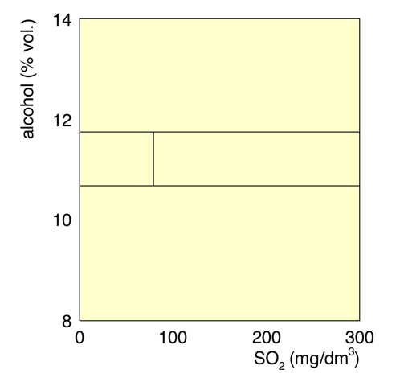
Decision Trees
Geometrically, a decision tree
is a d-dimensional histogram
in which the bins are
created recursively.

Slide 25
Decision Trees
Unfortunately, decision trees are unstable!

Slide 26
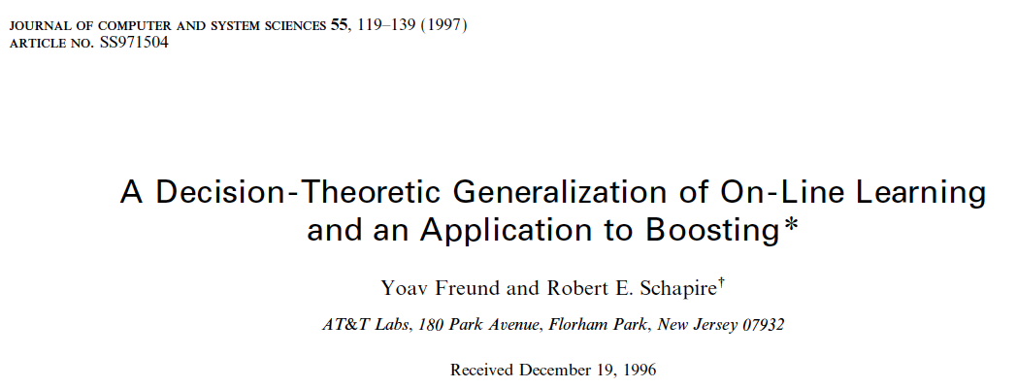
A Silk Purse from a Sow’s Ear!
In 1997, AT&T researchers Freund and Schapire [Journal of Computer and Sys. Sci. 55 (1), 119 (1997)] showed that it was possible to build highly effective classifiers by combining a large number of mediocre ones!
The Freund-Schapire algorithm, which they called AdaBoost, was the first successful method to boost (i.e., enhance)
the performance of
poorly performing
classifiers by
averaging their outputs.

Slide 27
A Silk Purse from a Sow’s Ear!
The most popular methods (used mostly with decision trees) are:
Bagging: each tree is trained on a bootstrap* sample drawn from the training set
Random Forest: bagging with randomized trees
Boosting: each tree trained on a different reweighting of the training set
*A bootstrap sample is a sample of size N drawn, with replacement, from another of the same size. Duplicates can occur and are allowed.

Slide 28
Example: Wine tasting!

Slide 29
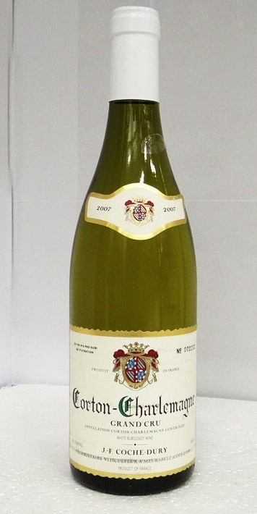
Wine Tasting
Wine tasting is big business. But, can a machine do it?
In principle, yes, if we can establish the
physical attributes that define “good” wine,
such as this one for $117,000 a bottle!

Slide 30
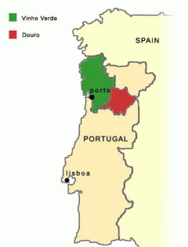
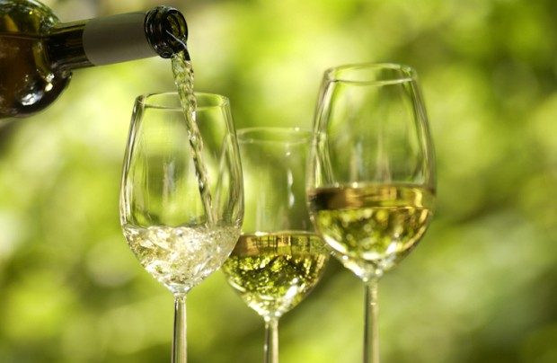
Wine Tasting
We’ll use AdaBoost to build a classifier to distinguish good wines from bad wines
from
Vinho Verde
in Portugal.
.

Slide 31
Wine Tasting
Let’s define a good wine as one with expert rating ≥ 0.6 on a scale from 0 to 1, where 1 is a wine from Heaven and 0 is a wine from Hell!
We’ll use data from
Cortez et al.*
* P. Cortez, A. Cerdeira, F. Almeida, T. Matos and J. Reis.
Modeling wine preferences by data mining from physicochemical properties.
In Decision Support Systems, Elsevier, 47(4):547-553. ISSN: 0167-9236

Slide 32
Wine Tasting: Data
Data: [Cortez et al., 2009].
variables description
acetic acetic acid
citric citric acid
sugar residual sugar
salt NaCl
SO2free free sulfur dioxide
SO2tota total sulfur dioxide
pH pH
sulfate potassium sulfate
alcohol alcohol content
quality (between 0 and 1)

Slide 33
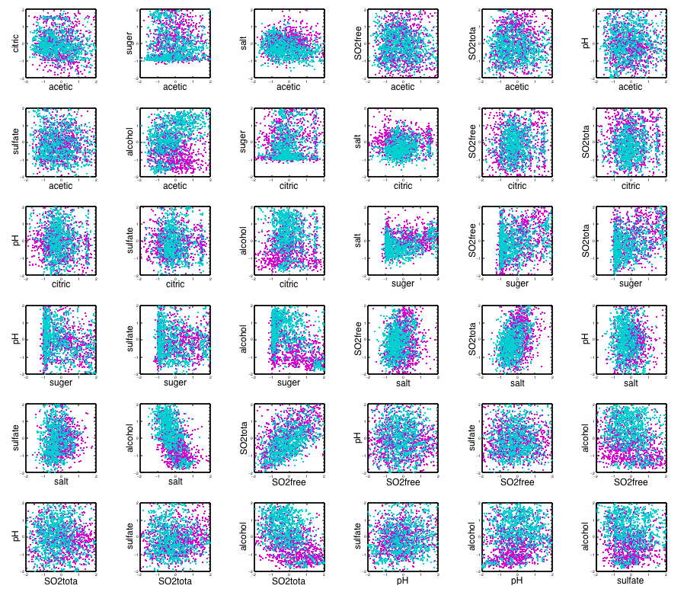

Slide 34
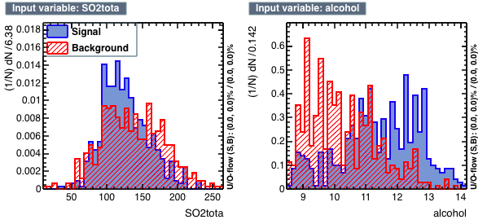
Wine Tasting: Variables
Variables:
SO2tota: the total sulfur dioxide content (mg/dm³)
alcohol: alcohol content (% volume)

Slide 35
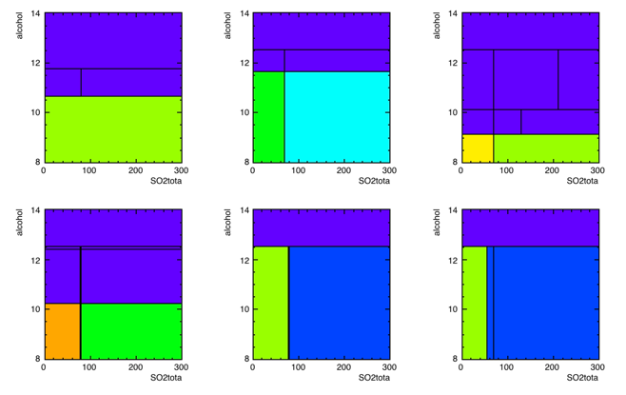
Wine Tasting: First 6 Decision Trees

Slide 36
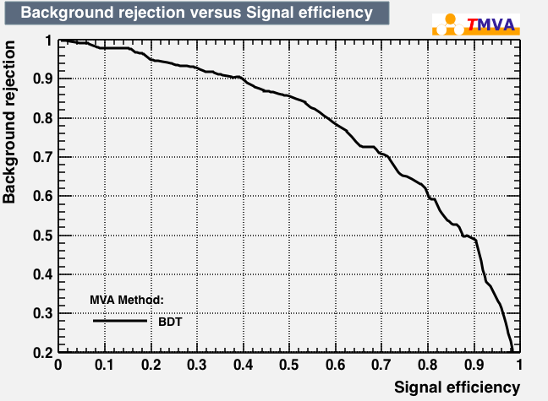
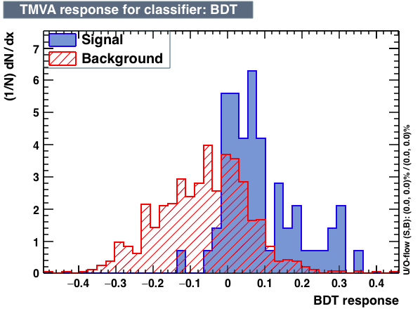
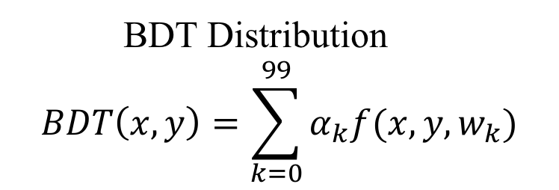
Wine Tasting: Results
x = SO2tota
y = alcohol
BDT Distribution
$$BDT\left(x, y\right)=\sum_{k=0}^{99}{α_{k}f(x, y, w_{k})}$$
Fraction of bad wine rejected
for a given fraction of good
wine accepted.

Slide 37
Deep neural networks

Slide 38
Deep Neural Networks
input layer layer 0 layer 1 layer 2
x h₁= h(b₀ + w₀x)
h₂ = h(b₁ + w₁h₁)
o = g(b₂ + w₂h₂)

Slide 39
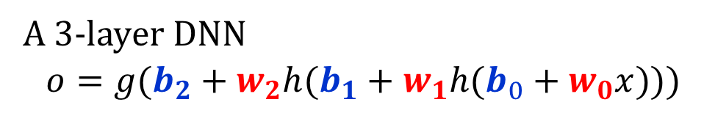
Deep Neural Networks
input layer layer 0 layer 1 layer 2
A 3-layer DNN
$$o=g(b_{2}+w_{2}h(b_{1}+w_{1}h(b_{0}+w_{0}x)))$$
h(z) = ReLU(z) [= max(0, z)], tanh(z)
g(z) = Identity(z), logistic(z) = 1/[1 + exp(-z)]

Slide 40
Deep Neural Networks
In 2006, University of Toronto researchers Hinton, Osindero, and Teh (HOT*) succeeded in training a deep neural network for the first time. Each layer was trained to produce a representation of its inputs that served as the training data for the next layer. Then the entire network was adjusted using gradient descent.
This breakthrough seemed to provide compelling evidence that the training of deep neural networks requires careful initialization of parameters and sophisticated machine learning algorithms.
* Hinton, G. E., Osindero, S. and Teh, Y. (HOT), A fast learning algorithm
for deep belief nets, Neural Computation 18, 1527-1554.

Slide 41
Deep Neural Networks
But, in 2010, Cirȩsan et al.* showed that such cleverness was not needed! The authors succeeded in training a DNN with architecture (784, 2500, 2000, 1500, 1000, 500, 10) that classified the hand-written digits in the MNIST database.
The database comprises 60,000 28×28 = 784 pixel images for training and validation, and 10,000 for testing.
The error rate of their ~12-million parameter DNN was 35 images out of 10,000. The misclassified images are shown on the next slide.
* Cirȩsan DC, Meier U, Gambardella LM, Schmidhuber J. , Deep, big,
simple neural nets for handwritten digit recognition. Neural Comput. 2010 Dec;
22 (12): 3207-20. http://yann.lecun.com/exdb/mnist/

Slide 42
(784, 2500, 2000, 1500, 1000, 500, 10)
Upper right: correct answer; lower left answer of highest DNN output;
lower right answer of next highest DNN output.

Slide 43
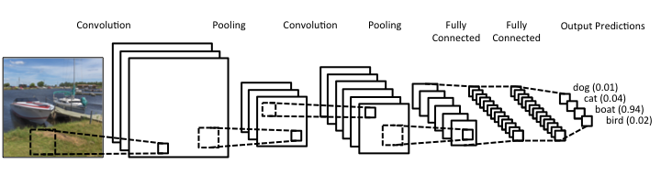
Convolutional Neural Networks
Many of the remarkable breakthroughs in tasks such as face recognition use a type of DNN called a convolutional neural network (CNN).
CNNs are functions that compress data and classify objects using their compressed representations via a standard fully connected NN. The compression dramatically reduces the dimensionality of the space to be searched.
Source: https://www.clarifai.com/technology

Slide 44
The future of machine learning

Slide 45
Machine Learning and AI
The most far-reaching application of machine learning is of course artificial intelligence (AI).
There is a huge amount of hype associated with AI. And we are far from being able to create systems that possess the innate heuristic algorithms that make us human.
However, it important that we not become complacent because, for better of worse, we do seem to be at the dawn of a revolution based on machine learning-based AI.

Slide 46
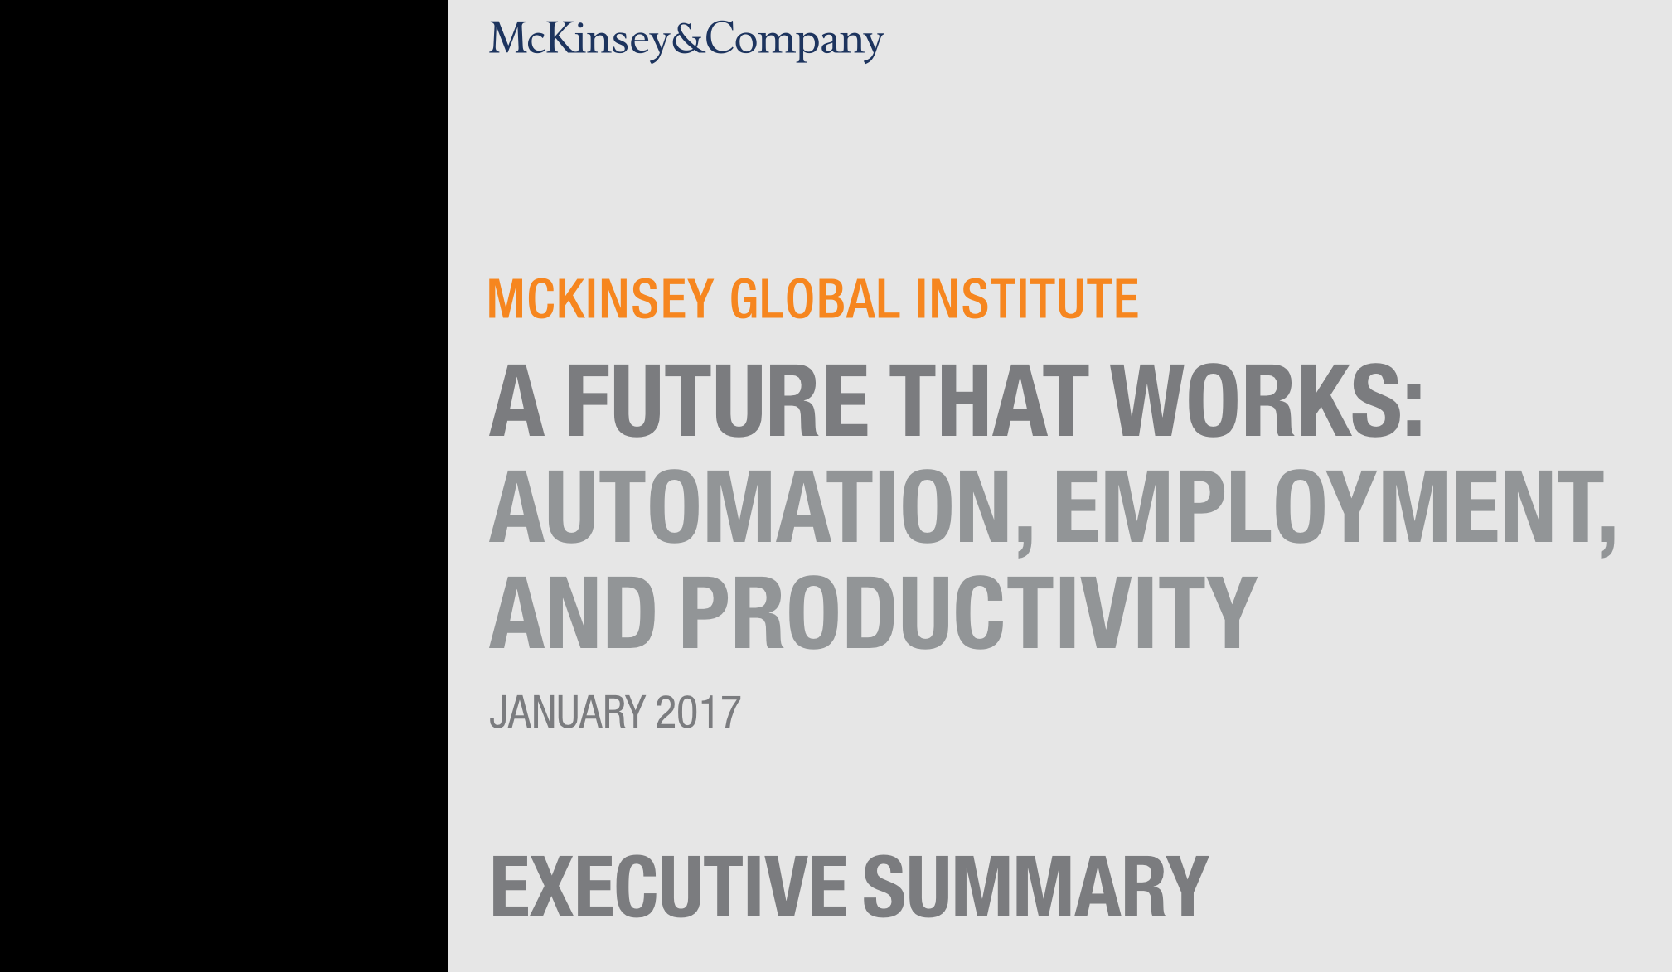

Slide 47
“Almost half the activities people are paid almost $16 trillion in wages to do in the global economy have the potential to be automated by adapting currently demonstrated technology, according to our analysis of more than 2,000 work activities across 800 occupations.”
McKinsey & Company,
A FUTURE THAT WORKS: AUTOMATION, EMPLOYMENT, AND PRODUCTIVITY
Executive Summary January 2017

Slide 48
The Future of Machine Learning
By 2050, the following might be in routine use:
autonomous personal predictive medical systems
autonomous personal tutors
autonomous physician’s assistant
autonomous house servant
autonomous pet sitter
autonomous vehicles that can drive safely on the M1!
The potential of machine learning and AI is vast and exciting.
But it has been argued (e.g, Bill Gates, Elon Musk, the late Stephen Hawking) that the dangers are also vast and fearsome: autonomous, self-aware, drone soldiers, AI drone swarms, AI-enabled computer viruses…

Slide 49
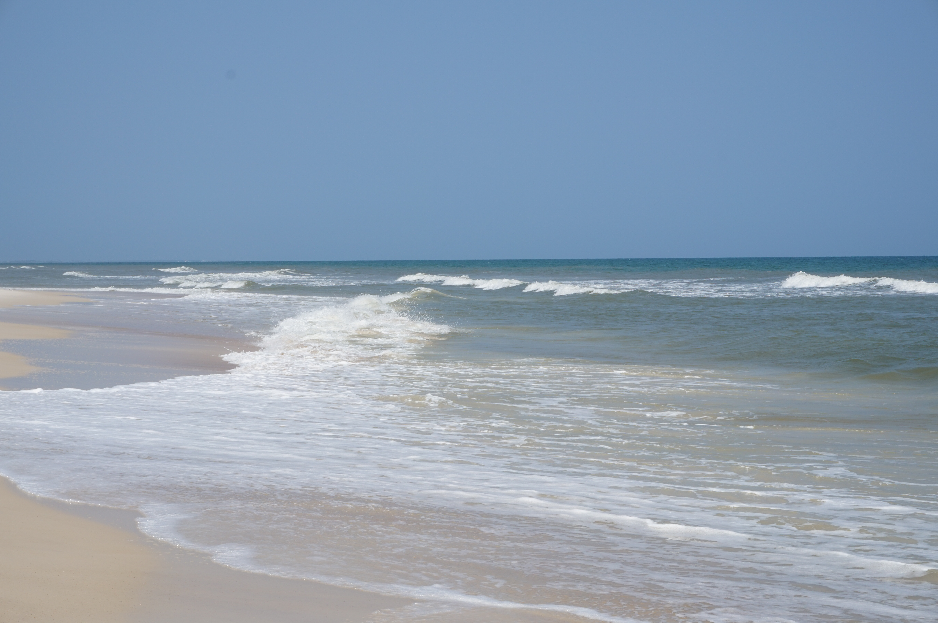
Thank You!
“Doubt is not a pleasant condition, but certainty
is an absurd one”
Voltaire

Slide 50
Hands-On Exercises
Dependencies
python 2.7.x, x > 9
numpy array manipulation
pandas DataFrame manipulation
matplotlib plotting
scikit-learn simple machine learning toolkit
Also useful:
scipy mathematical stuff for scientists
sympy amazing symbolic algebra package
Installation
git clone https://github.com/hbprosper/YETI

Slide 51
Hands-On Exercises
Exercises
01 wine classification (BDT)
02 wine quality regression (fully connected DNN)
03 Higgs boson VBF vs ggF (fully connected DNN)
04 MNIST hand written digit classification (DNN)

Slide 52
backup

Slide 53
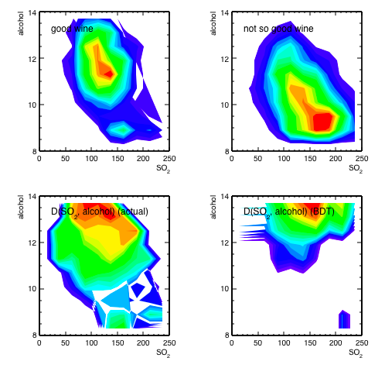
Wine Tasting: Results
The upper figures
are density plots of
the training data.
The lower plots are
approximations of
the discriminant
D(x, y)
The left, uses 2-D
histograms, the right
uses the BDT.

Slide 54
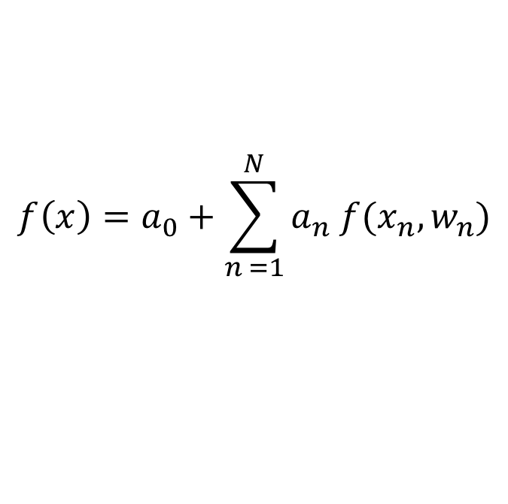
Ensemble Methods
Suppose you have an ensemble of classifiers f (x, w_{k}), which, individually, perform only marginally better than random guessing. Such classifiers are called weak learners.
It is possible to build highly effective classifiers by averaging their outputs:
$$f\left(x\right)=a_{0}+\sum_{n =1}^{N}{a_{n} f(x_{n}, w_{n})}$$
Jerome Friedman & Bogdan Popescu (2008)

Slide 55
DEEP Neural networks

Slide 56
Adaptive Boosting
The AdaBoost algorithm of Freund and Schapire uses decision trees f (x, w) with weights w assigned to each object to be classified, and each assigned a target value of either y = +1, or –1, e.g., +1 for signal, –1 for background.
The value assigned to each leaf of f (x, w) is also ±1.
Consequently, for object n, associated with values (y_{n}, x_{n})
f (x_{n}, w) y_{n} > 0 for a correct classification f (x_{n}, w) y_{n} < 0 for an incorrect classification
Y. Freund and R.E. Schapire. Journal of Computer and Sys. Sci. 55 (1), 119 (1997)

Slide 57
Adaptive Boosting
Initialize weights w in training set (e.g., setting each to 1/N)
for k = 1 to K:
Create a decision tree f (x, w) using the current weights.
Compute its error rate ε on the weighted training set.
Compute α = ln (1– ε) / ε and store as α _{k} = α
Update each weight w_{n} in the training set as follows: w_{n} = w_{n} exp[–α _{k} f (x_{n}, w) y_{n}] /A, where A is a normalization constant such that ∑w_{n} = 1. Since f (x_{n}, w) y_{n} < 0 for an incorrect classification, the weight of misclassified objects is increased.
At the end, compute the average f (x) = ∑ α_{k} f (x, w_{k})
Y. Freund and R.E. Schapire. Journal of Computer and Sys. Sci. 55 (1), 119 (1997)

Slide 58
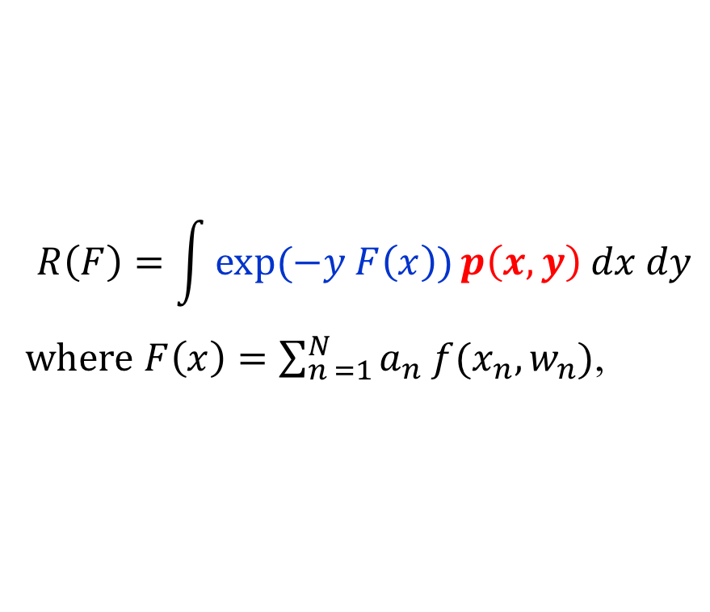
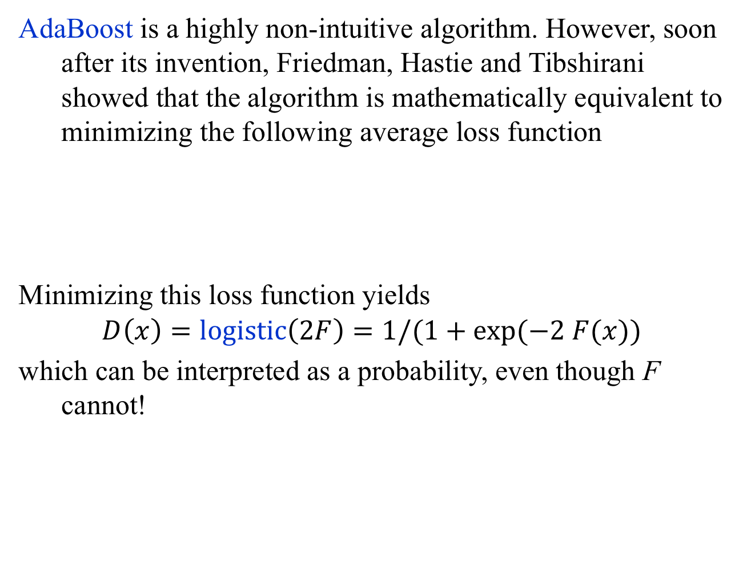
Adaptive Boosting
AdaBoost is a highly non-intuitive algorithm. However, soon after its invention, Friedman, Hastie and Tibshirani showed that the algorithm is mathematically equivalent to minimizing the following average loss function
Minimizing this loss function yields
$$D\left(x\right)=logistic\left(2F\right)=1/(1+exp⁡(−2 F(x))$$
which can be interpreted as a probability, even though F cannot!
$$R\left(F\right)=\int{\exp{(−y F\left(x\right))}p\left(x, y\right) dx dy}$$
$where$ $F\left(x\right)=\sum_{n =1}^{N}{a_{n} f(x_{n}, w_{n})}$,
J. Friedman, T. Hastie and R. Tibshirani, “Additive logistic regression: a statistical view of boosting,” The Annals of Statistics, 28(2), 377-386, (2000)

Slide 59
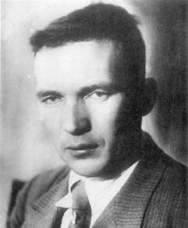
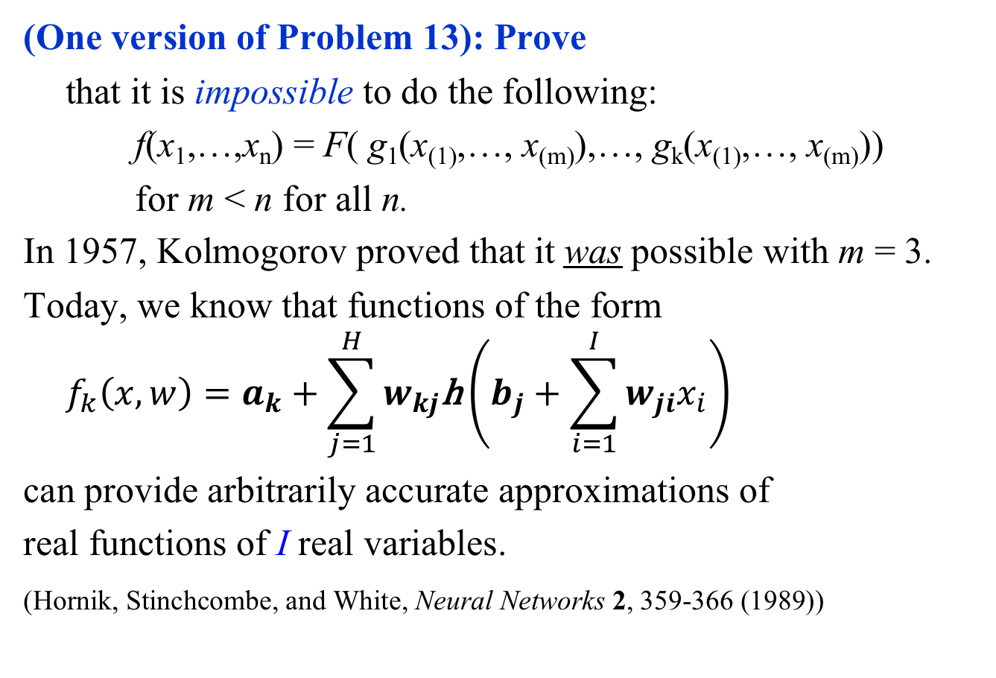
A Bit of History: Hilbert’s 13th Problem
(One version of Problem 13): Prove
that it is impossible to do the following:
f(x₁,…,x_{n}) = F( g₁(x₍₁₎,…, x_{(m)}),…, g_{k}(x₍₁₎,…, x_{(m)}))
for m < n for all n.
In 1957, Kolmogorov proved that it was possible with m = 3.
Today, we know that functions of the form
$$f_{k}\left(x,w\right)=a_{k}+\sum_{j=1}^{H}{w_{kj}\text{h}\left(b_{j}+\sum_{i=1}^{I}{w_{ji}x_{i}}\right)}$$
can provide arbitrarily accurate approximations of
real functions of I real variables.
(Hornik, Stinchcombe, and White, Neural Networks 2, 359-366 (1989))

Slide 60

Convolutional Neural Networks
A CNN comprises three types of processing layers: 1. convolution, 2. pooling, and 3. classification.
Convolution layers The input layer is “convolved” with one or more matrices using element-wise products that are then summed. In this example, since the sliding matrix fits 9 times, we compress the input from a 5 x 5 to a to a 3 x 3 matrix.

Slide 61
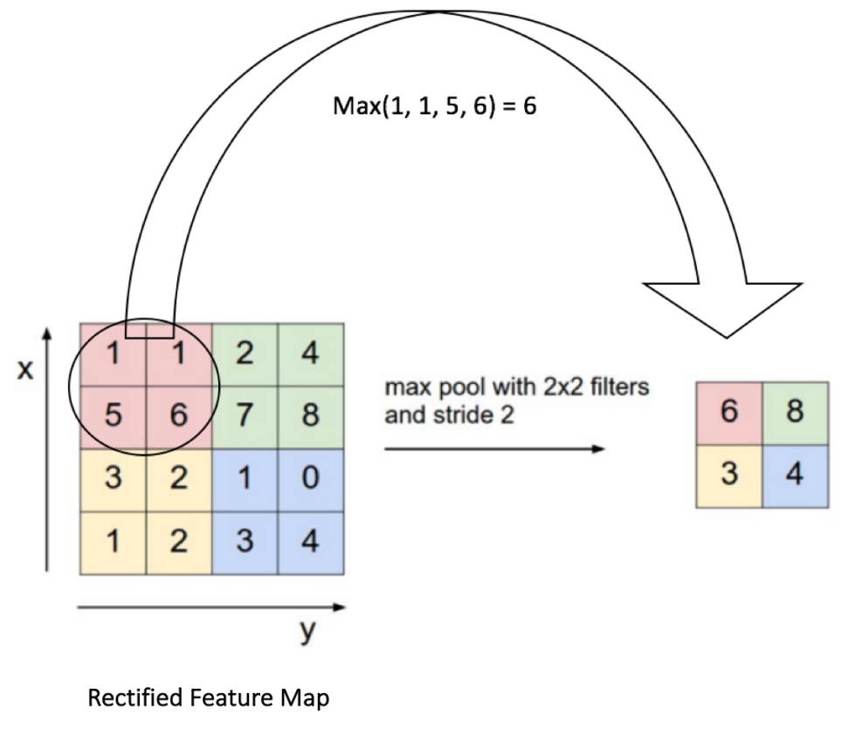
Convolutional Neural Networks
Pooling Layers After convolution, and a pixel by pixel non-linear map (using, e.g., the function y = max(0, x) = ReLU(x)), a coarse-graining of the layer is performed called max pooling in which the maximum values within a series of small windows are selected and become the output of a pooling layer.

Slide 62
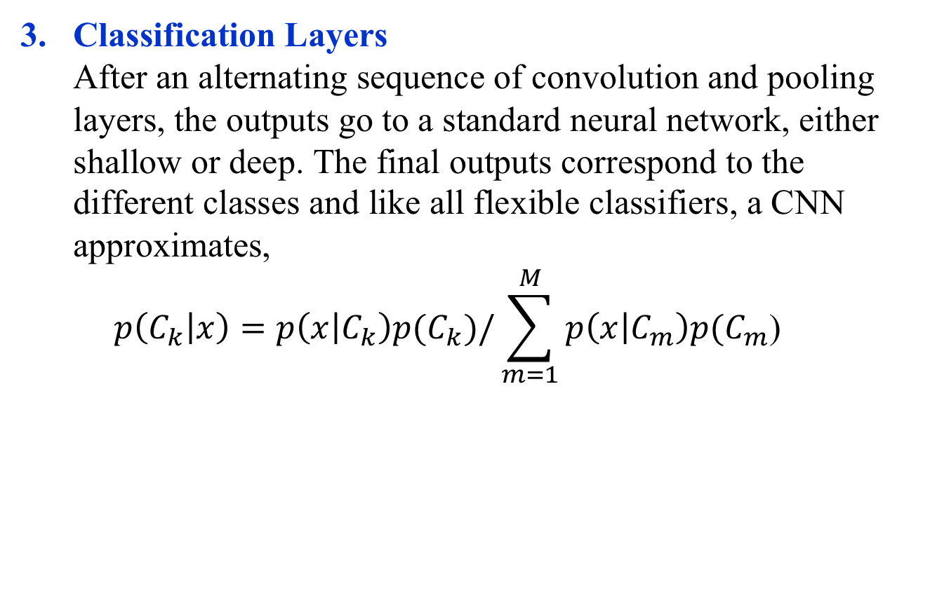
Convolutional Neural Networks
Classification Layers After an alternating sequence of convolution and pooling layers, the outputs go to a standard neural network, either shallow or deep. The final outputs correspond to the different classes and like all flexible classifiers, a CNN approximates, $p\left(C_{k} | x\right)=p\left(x | C_{k}\right)p(C_{k})/\sum_{m=1}^{M}{p\left(x | C_{m}\right)p(C_{m}\text{)}}$

